Slide 1
AI IN MANUFACTURING
ME15B095 - CHETAN
ME15B102 - JAYARAM
ME15B109 - DHARAMVEER
ME15B111 - SREEKAR

Slide 2
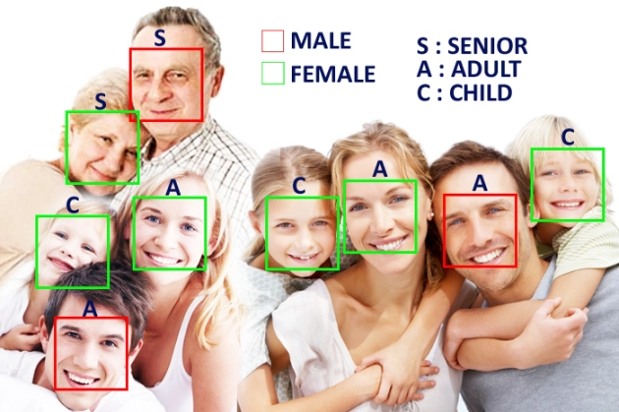
PROBLEM STATEMENT
AGE AND GENDER ESTIMATION USING FACIAL RECOGNITION

Slide 3
APPROACH TO PROBLEM
DATA SETS USED FOR AGE AND GENDER ESTIMATION - UTKFACE, IMDB WIKI, MORPH , VISAGE
AGE ESTIMATION IS PERFORMED BY ASSIGNING A SET OF FACIAL FEATURES TO AN AGE GROUP . EG: WRINKLES
IMAGE PREPROCESSING SUCH AS CROPPING THE FACE USING BOUNDING BOXES, NOISE REMOVAL ETC.
ALGORITHMS TO BE USED CNN, MOBILE NET OR RESNET

Slide 4
APPLICATIONS
During mass requirement of manual labour in manufacturing industries, it is practically impossible to categorize each of them on the basis of their age.
By using our algorithm can automatically categorize labour into different tasks with different age requirements.
Age and Gender BASED ACCESS CONTROL
Age related entrance restrictions may apply to different premises
Prevention of purchase of certain goods like alcoholic drinks or cigars by under . individuals
AGE ADAPTIVE HUMAN MACHINE INTERACTION
Persons belonging to different age groups need to interact with machines in different ways
Automatic age estimation algorithms can be used here to automatically adjust user interface in order to suit the needs of their age group

Slide 5
THANK YOU

